Slide 1
A Personalized Recommender System Based on Users’ Information In Folksonomies
Date: 2013/12/18
Author: Mohamed Nader Jelassi, Sadok Ben Yahia, Engelbert Mephu Nguifo
Source: Kdd’13
Advisor: Jia-Ling Koh
Speaker: Pei-Hao Wu

Slide 2
Outline
Introduction
Method
Experiments
Conclusion

Slide 3
Introduction
Motivation
help users solve the overload issue and
provide personalized information
Consider user’s profile to personalized recommend in folksonomies

Slide 4
Introduction
This system will recommend tags, users, resources to users
Before it recommends, user must provide his profile like age, profession and gender
User has to share some movies with some tags or otherwise the system will recommend the information only based on their profile

Slide 5
Introduction
Share the movie:
Recommend the movie:
Profile
Dataset
(User, Profile, Resource, Tag)
User
Resource
(Movie)
Tag
Dataset
Tag
Resource
(Movie)
User
Recommend System
User

Slide 6
Introduction
Which method can get useful personalized information form folksonomy
QUADRATIC CONCEPTS
How to get the personalized recommend
PERSOREC algorithm

Slide 7
Outline
Introduction
Method
Experiments
Conclusion

Slide 8
Folksonomies
Folksonomy consists of three sets: U, T, R
U is a set of users
T is a set of tags
R is a set of resource
This paper mention it use to class the movie
Ex: “Andy” annotated the movie “Toy Story” by the tag “adventure”

Slide 9
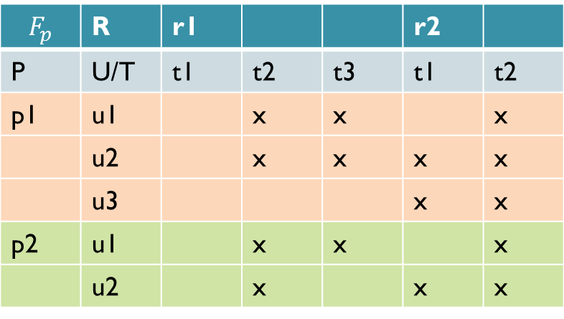
P-Folksonomy
$F_{p}$=(U, T, R, P, Y)
P is a set of users’ profiles
Y ⊆ U × T × R × P
Ex: “Andy” with the profile “student” annotated the movie “Toy Story” by the tag “adventure”
$$F_{p}$$ | R | r1 |  |  | r2
P | U/T | t1 | t2 | t3 | t1 | t2
p1 | u1 |  | x | x |  | x
 | u2 |  | x | x | x | x
 | u3 |  |  |  | x | x
p2 | u1 |  | x | x |  | x
 | u2 |  | x |  | x | x
An example of a p-folksonomy

Slide 10
Quadratic Concepts
A quadratic concept of a p-folksonomy $F_{p}$ = (U , T , R , P , Y) is a quadruple (u, t,
r, p) with u ⊆ U, t ⊆ T, r ⊆ R and p ⊆ P
u× t × r × p ⊆ Y
such that the quadruple (U , T , R , P) is maximal
i.e., none of these sets can be extended without shrinking one of the other three dimensions

Slide 11
Quadratic Concepts
Use “frequent” quadri-concepts
Find “frequent” quadri-concepts by the QUADRICONS algorithm
Define minimum thresholds on each dimension of the p-folksonomy
Ex:
${QC}_{1}$={ ($u_{1},u_{3}$), ($t_{2},t_{3},t_{4}$), ($r_{1}$, $r_{2}$), ($p_{1}$, $p_{2}$)
${QC}_{2}$={ ($u_{1},u_{2}$), ($t_{2},t_{3},t_{4}$), ($r_{1}$, $r_{3}$), ($p_{1}$, $p_{2}$)

Slide 12
PERSOREC: A PERSONALIZED RECOMMENDER SYSTEM FOR FOLKSONOMIES
An algorithm for a personalized recommendation in folksonomies
According to user’s profile and resource, it can suggest user the list of other users, the list of tags and the list of resources that the user will be interested

Slide 13
Outline
Introduction
Method
Experiments
Conclusion

Slide 14
Datasets
The MovieLens filmography dataset
Over 50,000 users
95580 tags
10681 movies
Users’ profiles(age, gender, profession)

Slide 15
Datasets
Because it very hard to find users with exactly the same age sharing same resources and same age, we part the age into five categories:
7 - 18 years
19 - 24 years
25 - 35 years
36 - 45 years
46 - 73 years

Slide 16
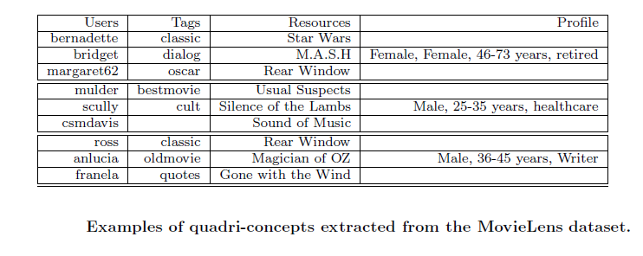
Experiment 1
Consider frequent quadri-concepts’ each dimension and their ${minsupp}_{u}=2,{minsupp}_{t}=2$, ${minsupp}_{r}=2$, ${minsupp}_{p}=2$

Slide 17
Experiment 2
Consider frequent quadri-concepts’ each dimension and their ${minsupp}_{u}=2,{minsupp}_{t}=2$, ${minsupp}_{r}=2$, ${minsupp}_{p}=1$

Slide 18
Experiment 2

Slide 19
Evaluation of the recommendation
Training set / Test set
100% dataset
80%
Training set
20% Test set
80%
Training set
20%
answer set

Slide 20
Evaluation of the recommendation
We consider “precision” for the efficiency of this system
Precision$=\frac{number of pertinent recommenddations}{number of recommendations}$

Slide 21
Evaluation of the recommendation
Top-K
User can specify the k recommendations the most relevant that the system shall return to him
Different value of k going from 5 to 10
Our approach compare with Liang et al.

Slide 22
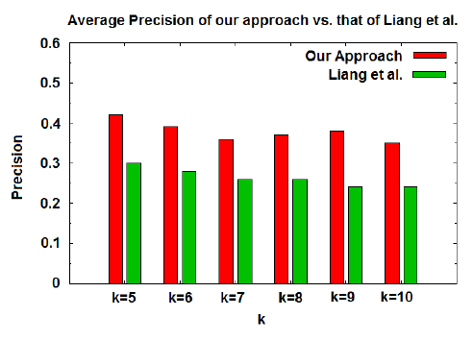
Evaluation of the recommendation
The average precision of our approach is 38% and Liang et al. is 27%
The best performances is obtained with a value of k=5

Slide 23
Outline
Introduction
Method
Experiments
Conclusion

Slide 24
Conclusion
Provide a originality approach to recommend personalized information
In this paper, we considered the users’ profile as a new dimension in the folksonomy and we use the QUADRICONS algorithm to mine quadratic concepts of user, tags, resources and profiles
Moreover, we may explore other domains, like time

